Slide 1
Neuroradiology CT rotation for 1st year Radiology Residents
A collection of the most commonly seen findings, cases, essential anatomy, and protocol pearls for review in order to succeed on this rotation.
Jeff Koning, M.D.
Updated August 2012

Slide 2
Protocol Pearls
A good overview of Neuro CT protocols has already been put together here: http://radres.ucsd.edu/documents/Neuro/Neuro-CT-Tech.pdf

Slide 3
Protocol Pearls
  As of the most recent revision of this document, CTAs of the head and neck for stroke codes do not involve the radiologist in protocolling the study. The CT techs should call you when there is a stroke code.
    Stroke code imaging includes:
      CTA of the head and neck, which includes a noncontrast CT of the Head, CTA from the aortic arch to the skull vertex, and 3D reformats of the CTA source images
  CT soft tissue necks are almost always done with IV contrast (one case where a CT of the neck without and with IV contrast is needed is for calcified masses such as thyroid CA). Sometimes ER orders CT soft tissue neck without IV contrast and almost always they are wanting a cervical spine CT, which should be protocolled by the bone resident

Slide 4
Protocol Pearls
CTs of the mandible are also misprotocolled occasionally and end up on the bone list. Usually when the ER orders CT mandible for facial trauma, they are wanting a maxillofacial CT and these should be protocolled without IV contrast.
Temporal bone studies are sometimes ordered as “CT orbit/sella/ear” so be sure to look under the indications and protocol it as a noncontrast Temporal bone on the 64 slice scanner, if appropriate
CT orbits are sometimes ordered for trauma when a maxillofacial CT would be more appropriate to further evaluate the potential for other facial trauma

Slide 5
Essential Anatomy
The following slides cover the most essential anatomy for success on the Neuro CT rotation

Slide 6
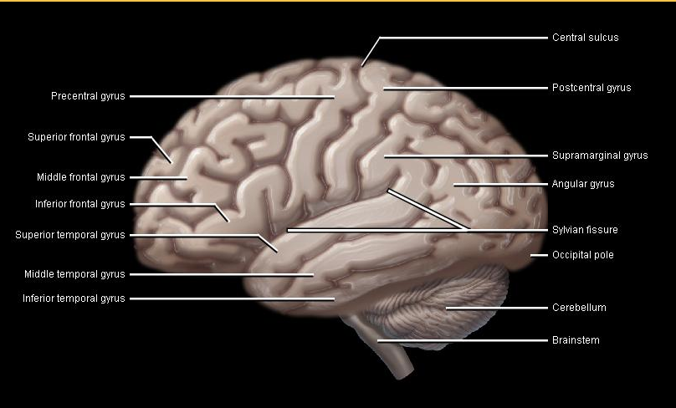
Fissures, Gyri, Sulci

Slide 7
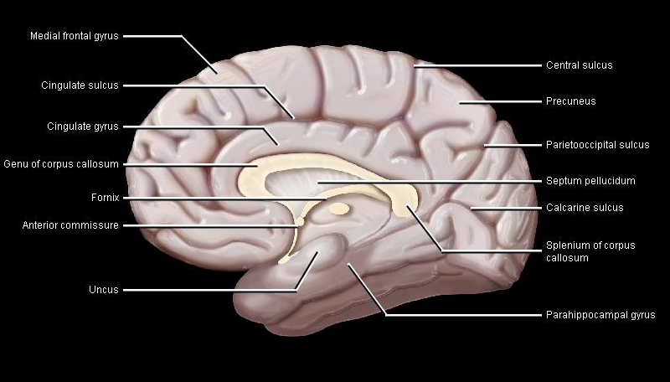
Fissures, Gyri, Sulci (Medial)

Slide 8
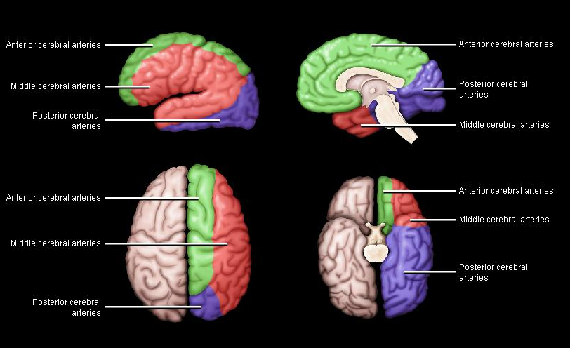

Slide 9
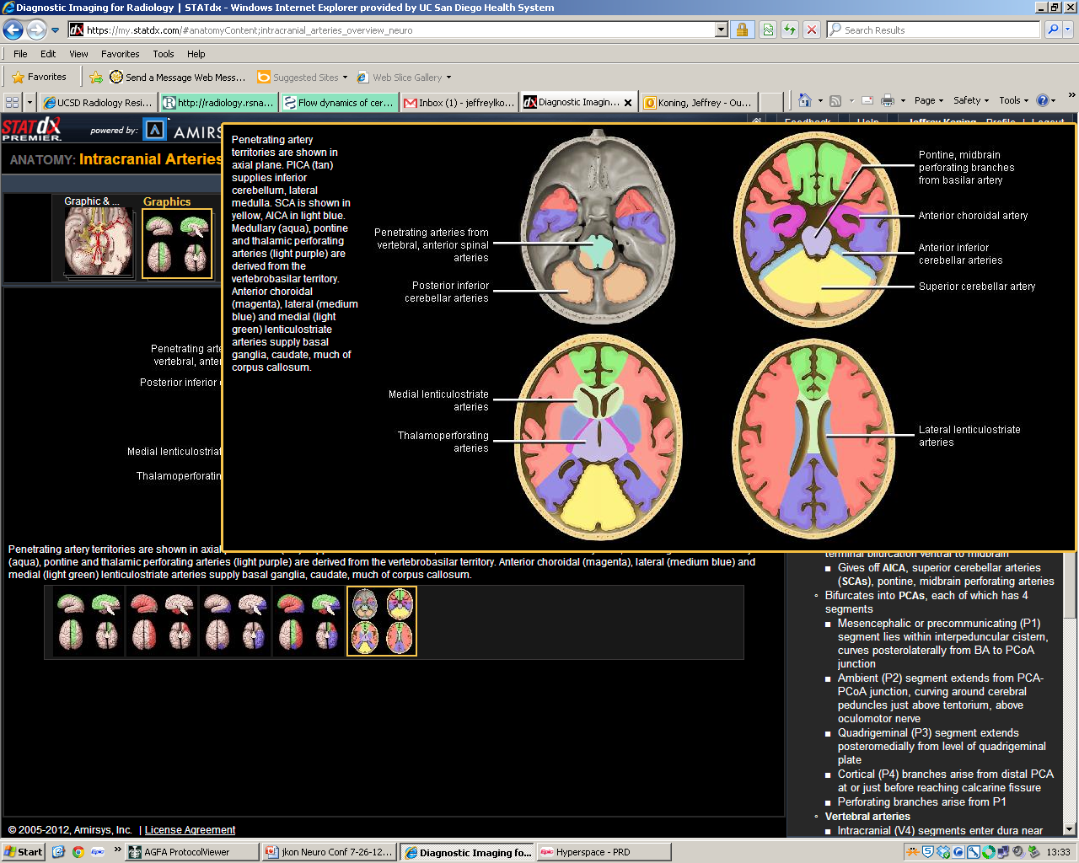

Slide 10
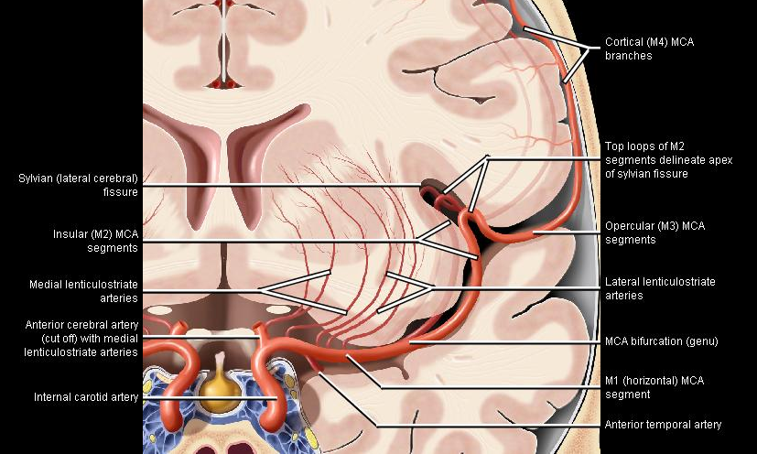

Slide 11
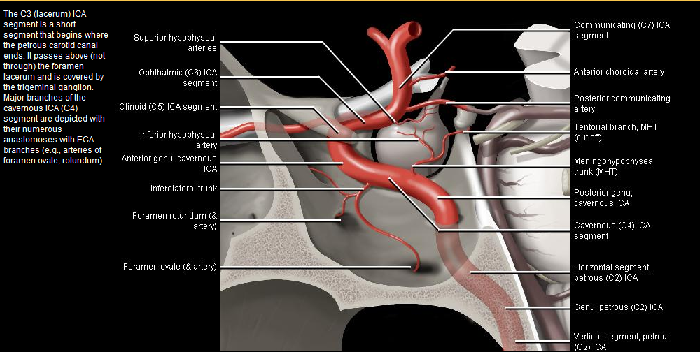

Slide 12
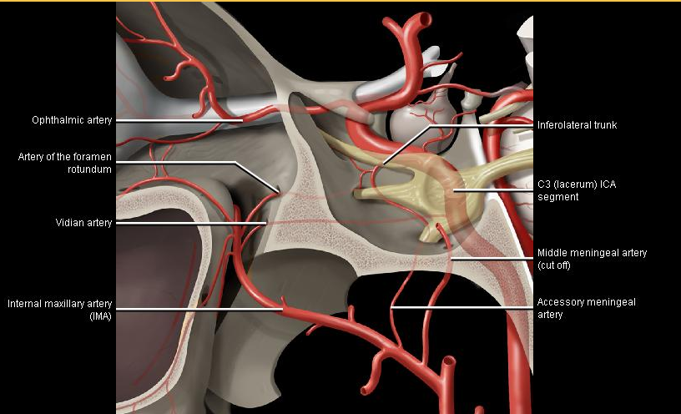
ECA to ICA anastomoses

Slide 13
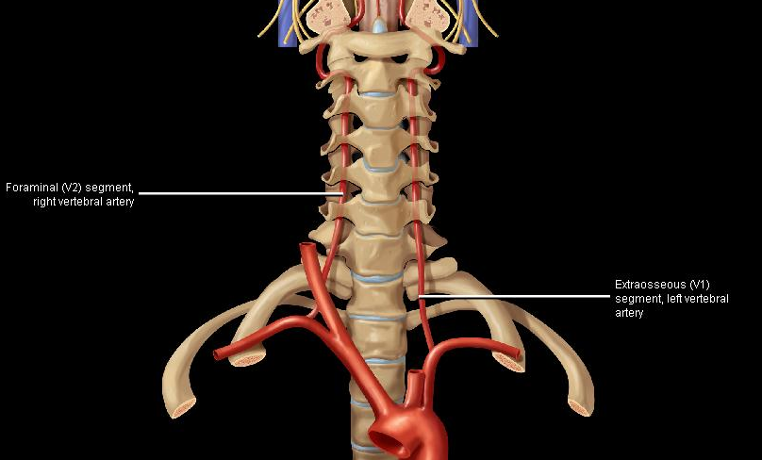
Vertebral Artery Anatomy

Slide 14
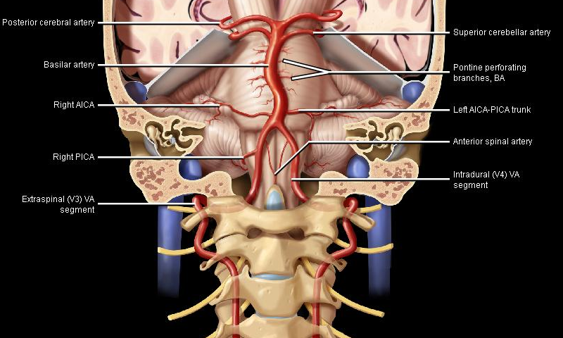
Vertebrobasilar System

Slide 15
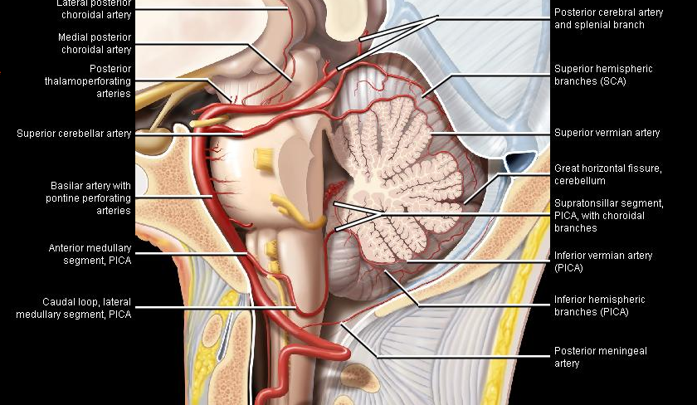
Posterior Circulation

Slide 16
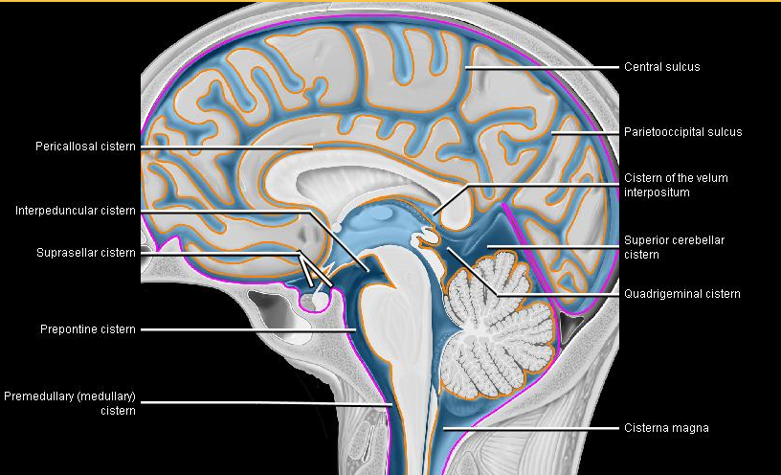
Important Cisterns

Slide 17
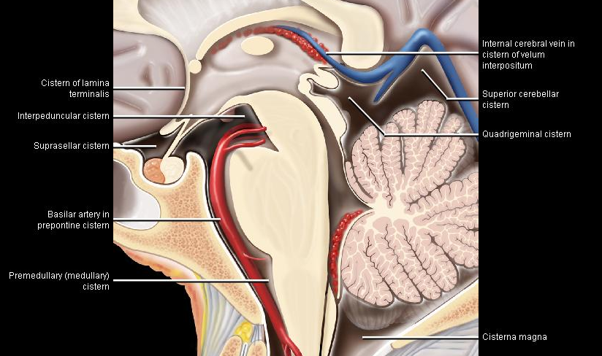
Important Cisterns

Slide 18
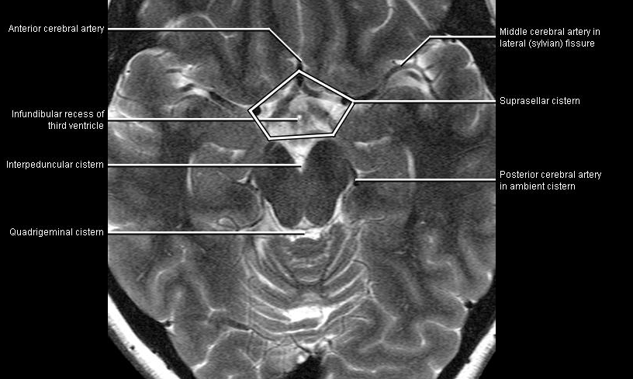
Cisterns

Slide 19
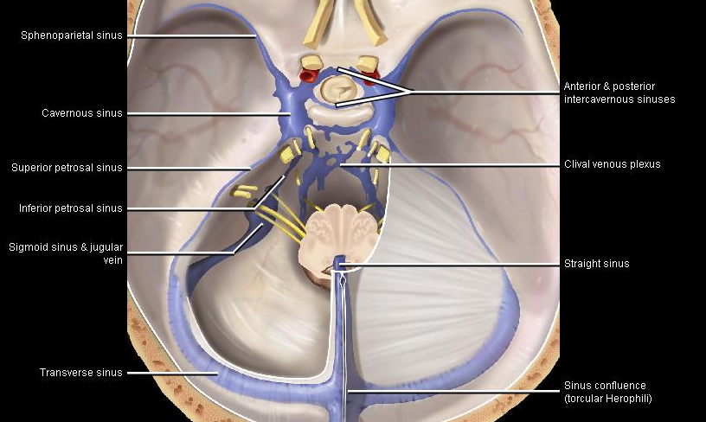
Important Venous Sinuses

Slide 20
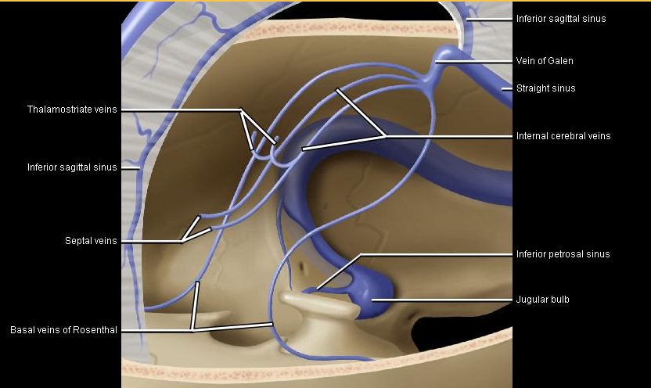
Important Venous Sinuses

Slide 21
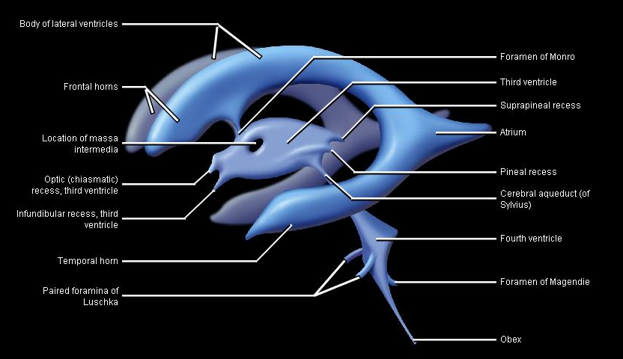
Ventricles

Slide 22
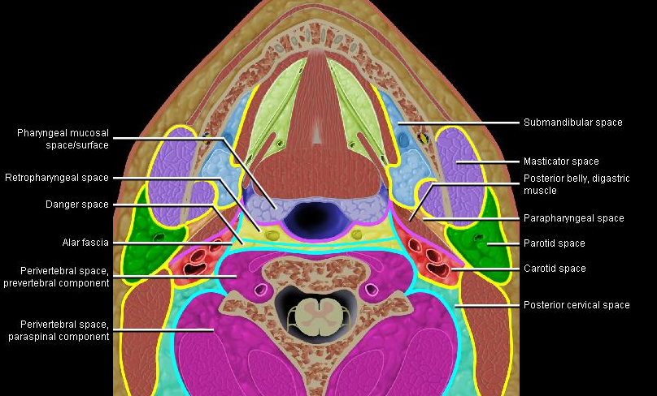
Layers of the Deep Cervical Fascia

Slide 23
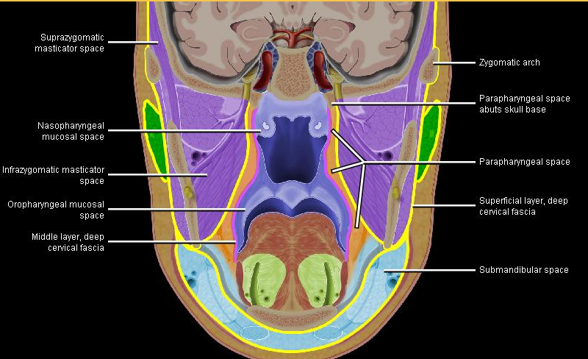
Layers of the Deep Cervical Fascia

Slide 24
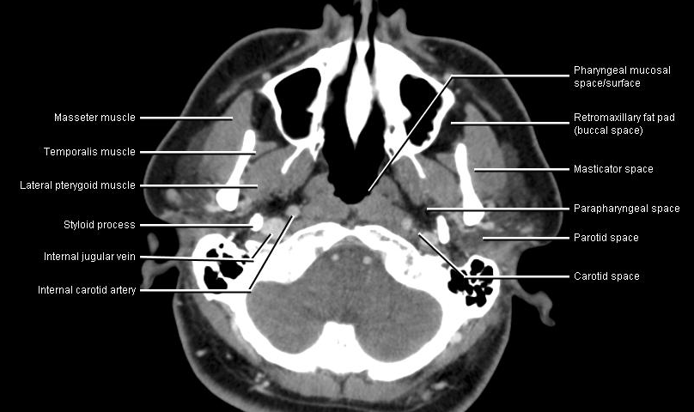
Deep Cervical Fascia on CT

Slide 25
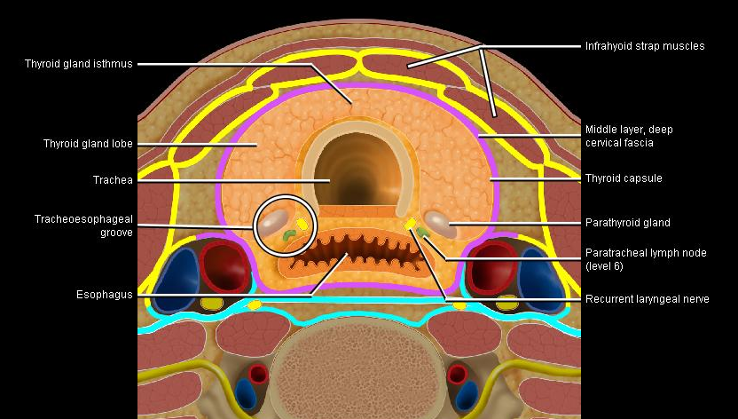
Thyroid Anatomy

Slide 26
Essential Anatomy
Its called essential for a reason!
If you want more, all of the images above were taken from StatDx, and there are plenty more there!

Slide 27
Image Evaluation Pearls
Noncontrast CT heads will be the most common study you will need to interpret
  You are usually given two head sequences with a standard algorithm, one reconstructed with 2.5 mm slices and another with 5 mm slices. The 5 mm slices are preferred when looking at the brain parenchyma, as they have less noise.
  You will also be given a head sequence with a bone algorithm reconstructed with 2.5 mm slices. This is best for looking at the sinuses, mastoid air cells, middle ear, and of course, the bones.
  Finally, you will be given sagittal and coronal reformats with a standard algorithm, which are best to look at midline structures, cerebellar tonsil position, tentorium, falx, subdural or epidural bleeds that may be difficult to see on axial cuts, etc.

Slide 28
Image Evaluation Pearls
Evaluating a noncontrast Head CT
  As always, be systematic
  Windowing Hot Keys to know:
    2: Soft tissues
    3: Bone
    5: Best for CTA sequences
    7: Brain Parenchyma
    8: Gray/White differntiation or “Stroke” windows
    9: Best for blood
    Other windowing tips:
      It can be helpful to use bone windows to evaluate the petrous ICAs and vertebral arteries around the skull base during CTA evaluation

Slide 29
Image Evaluation Pearls
Noncontrast maxillofacial CTs are commonly ordered on trauma patients who have also had head CTs
  Save yourself time and only talk about the sinuses, fractures, facial injuries, etc on one study and refer the clinician to the other study for the intracranial findings
  Again, coronal and sagittal reconstructions will be given, and orbital wall/maxillary wall fractures, midline structures, etc will be better appreciated on theses sequences
  Always ask for reconstructions if you notice they have not been sent over by the techs

Slide 30
Common Findings and their Descriptions
The following slides include some common findings and how to describe them that you should be familiar with.

Slide 31
Sinus Disease
Mucosal thickening
  Grade it as either “Mild, Moderate, or Severe”
Opacification
  Also, describe it as partial, near complete, complete
  Air fluid levels and bubbles indicate acute sinusitis
Mucous retention cyst/mucocele
  A mucocele is essentially a mucous retention cyst that causes mass effect (see next slide for example)
Bony thickening/sclerosis
  An indicator of chronic disease (see next slide)
Nasal polyps are not as commonly seen as the above findings
Typical dictations
  “Mild mucosal thickening is present within the right frontal sinus, right maxillary sinus, and right ethmoid air cells. Query symptoms of acute sinusitis.”
  “Complete opacification of the right maxillary sinus with sclerotic changes involving all walls of the right maxillary sinus, indicative of chronic sinusitis.”

Slide 32
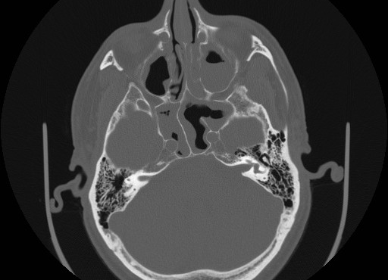
Sinus Disease
Below: mild mucosal thickening in the right maxillary sinus, near complete opacification of the left maxillary sinus with an air fluid level, near complete opacification and air bubbles in the right sphenoid sinus, and moderate mucosal thickening in the left sphenoid sinus. The mastoid air cells are clear bilaterally. Impression: Pansinusitis

Slide 33
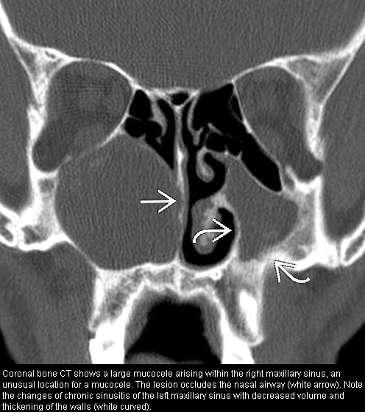

Slide 34
Chronic Changes in the Brain
Cerebrovascular calcifications
  Grade as mild, moderate, severe
  Commonly seen within the cavernous and supraclinoid internal carotid arteries, as well as the distal V4 segments (intradural) of the vertebral arteries
  Typical dictation: “Marked cerebrovascular calcifications are present within the bilateral cavernous and supraclinoid internal carotid arteries.”
Other benign calcifications
  Bilateral globus pallidi (mention these in the findings only)
  Pineal and choroid plexus (don’t mention these)
  Remote neurocysticercosis (common) or granulomatous disease
  Typical dications
    “Benign calcifications present within the bilateral globus pallidi.”
    “Scattered punctate calcifications present, consistent with remote granulomatous disease versus neurocysticercosis.”

Slide 35
Chronic Changes in the Brain
Volume loss
  Choose one way to describe and stick with it (Supratentorial/infratentorial, cerebral/cerebellar, diffuse, etc) and qualify it with mild, moderate, severe or “greater than expected for age”, or mild for age, or even “mild prominence of the lateral ventricles and sulci, greater than expected for age.”
White matter hypoattenuation
  Usually seen in the periventricular or subcortical regions, and while nonspecific, is most commonly due to hypertension or chronic small vessel ischemia
  Typical dictation: “Mild scattered nonspecific white matter hypoattenuation is noted, likely secondary to HTN or chronic microvascular ischemia.”
Old brain triad is cerebrovascular calcifications, white matter hypoattenuation, and volume loss.

Slide 36
Chronic Changes in the Brain
Lacunar infarcts vs perivascular spaces
  There is a great discussion in Brant and Helms on this
  Typical dictations
    “Small hypodensity seen in the posterior limb of the right internal capsule, likely sequelae of an old lacunar infarct.”
    “Tiny hypodensity seen in the right putamen at the level of the anterior commisure, likely a dilated perivascular space versus old lacunar infarct.”

Slide 37
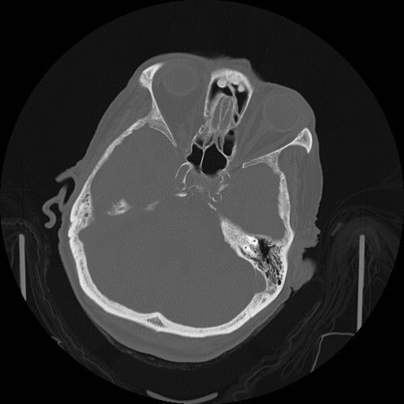
Marked Cerebrovascular Calcifications

Slide 38
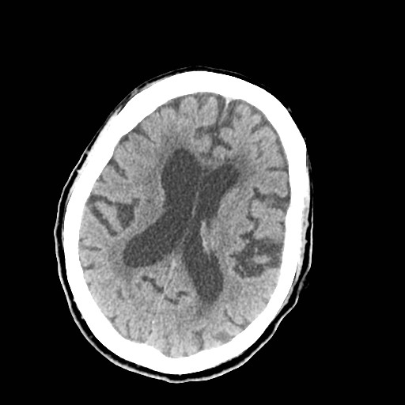
Moderate Periventricular White Matter Hypoattenuation

Slide 39
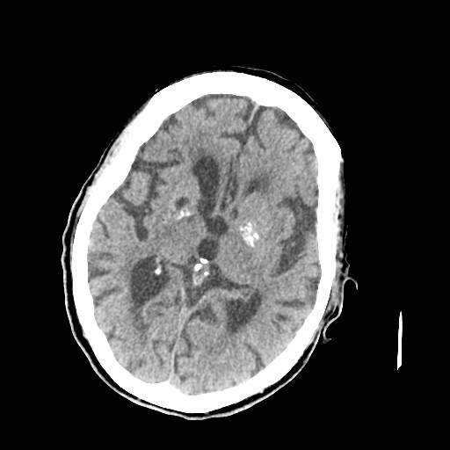
Lacunar Infarct Right Lentiform nucleus and Bilateral Globus Pallidi Calcifications

Slide 40
Case Examples
The following slides are a few case examples

Slide 41
Unknown age “Found Down”
MR 26118042
You will get this history frequently!
The following is a good example that they aren’t always negative studies

Slide 42
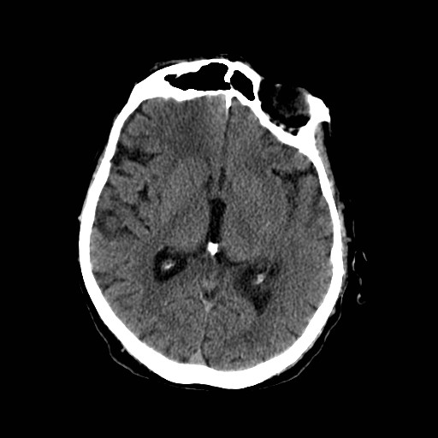

Slide 43
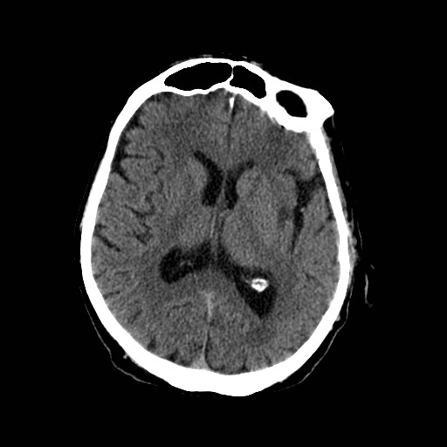

Slide 44
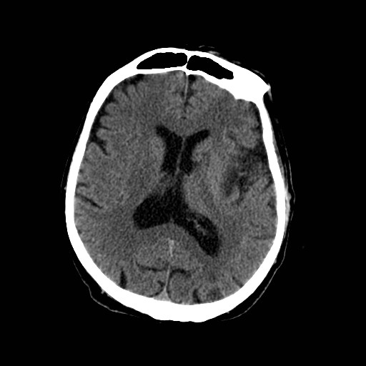

Slide 45
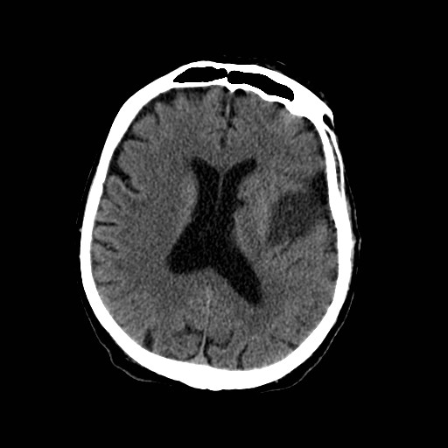

Slide 46
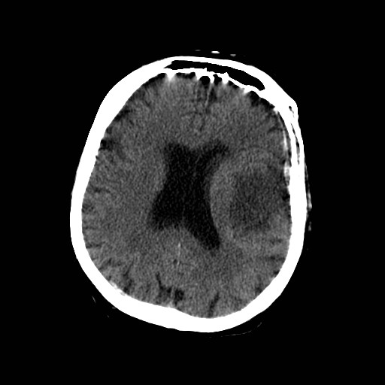

Slide 47
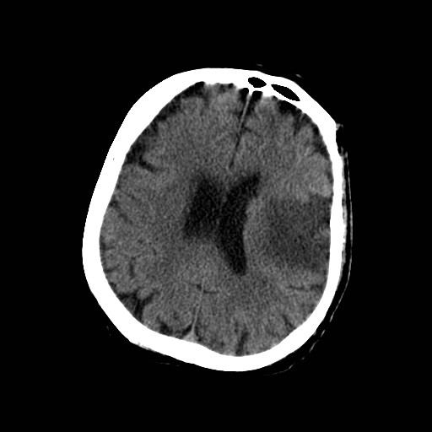

Slide 48
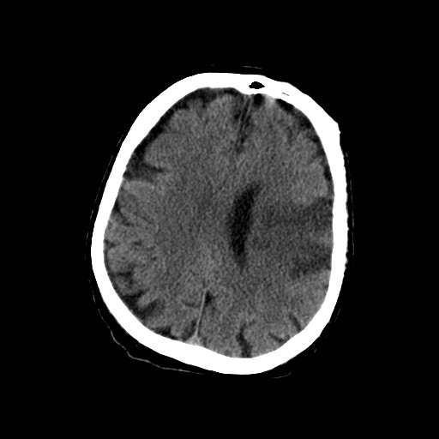

Slide 49
Left MCA Stroke
The following slide goes back over the anatomy and indicates branches of the left MCA that are occluded and those that aren’t involved

Slide 50
Notice the lenticulostriate arteries don’t appear to be involved, indicating the clot is likely distal to these branches

Slide 51
L MCA Infarct
Many causes (thrombotic vs. embolic, dissection, vasculitis, hypoperfusion)
Early: Critical disturbance in CBF
  Severely ischemic core has CBF < (6-8 cm³)/(100 g/min) (normal ~ [60 cm³]/[100 g/min])
  Oxygen depletion, energy failure, terminal depolarization, ion homeostasis failure
  Bulk of final infarct → cytotoxic edema, cell death
  Later: Evolution from ischemia to infarction depends on many factors
  Ischemic "penumbra" CBF between (10-20 cm³)/(100 g/min)
    Theoretically salvageable tissue
    Target of thrombolysis, neuroprotective agents
Associated abnormalities
  Cardiac disease, prothrombotic states
  Additional stroke risk factors: C-reactive protein, homocysteine

Slide 52
Parenchymal Hypodensity
DDx for Parenchymal Hypodensity (Nonvascular Causes)
  Infiltrating neoplasm (e.g., astrocytoma)
  Cerebral contusion
  Inflammation (cerebritis, encephalitis)
  Evolving encephalomalacia
  Dural venous thrombosis with parenchymal venous congestion and edema

Slide 53
Left MCA Stroke
The next slide gives the correlate MRI images, but don’t worry about these because you’ll only be reading CT during this rotation
They are obviously helpful to get a head start for the future, however.

Slide 54
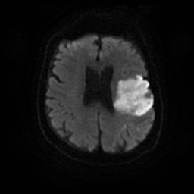
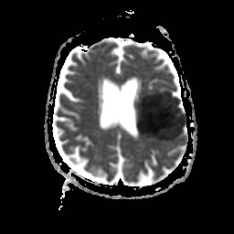
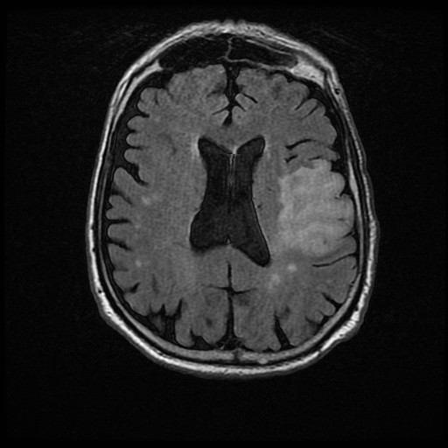
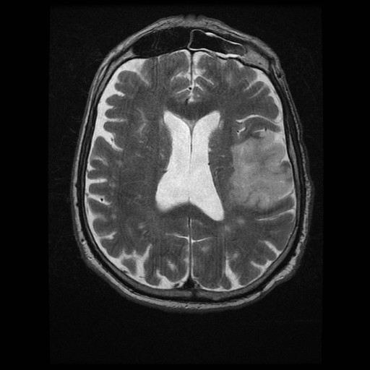

Slide 55
Left MCA Stroke
CT perfusion is done occasionally in an effort to locate the “penumbra”
There is a good discussion of this in Brant and Helms

Slide 56
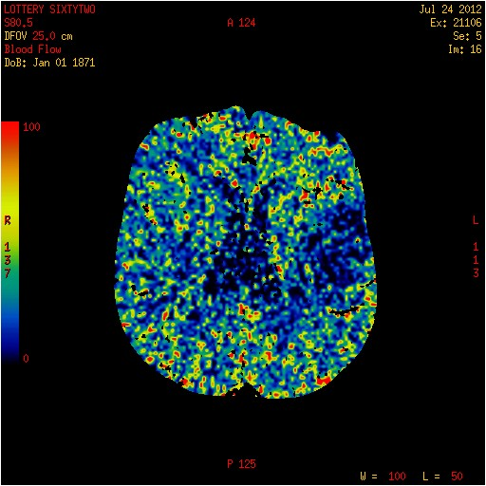

Slide 57
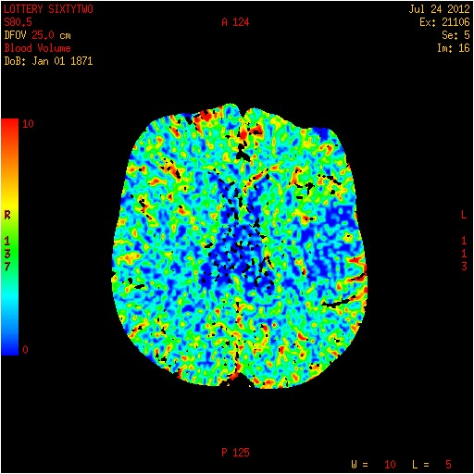

Slide 58
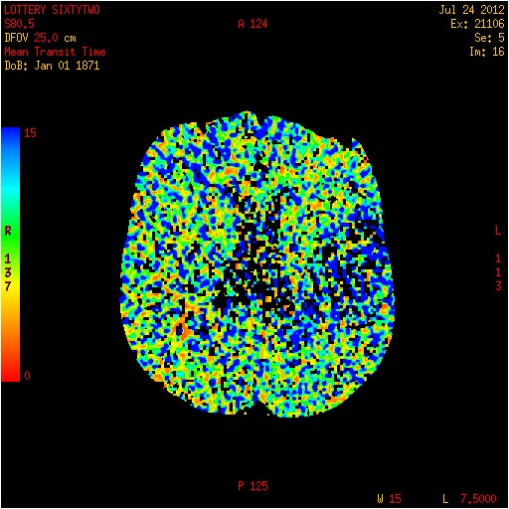

Slide 59
Left MCA Stroke
This patient had other imaging done in the neck which is shown on the following slides

Slide 60
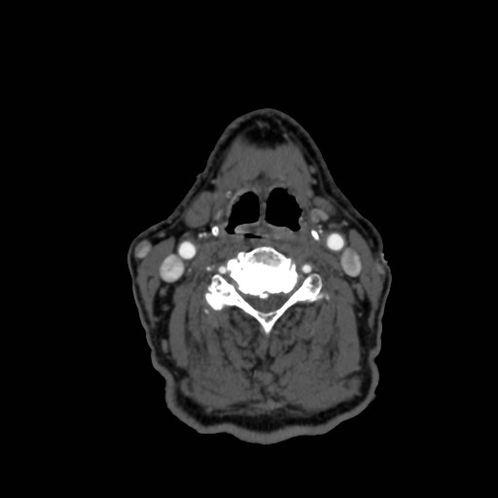

Slide 61
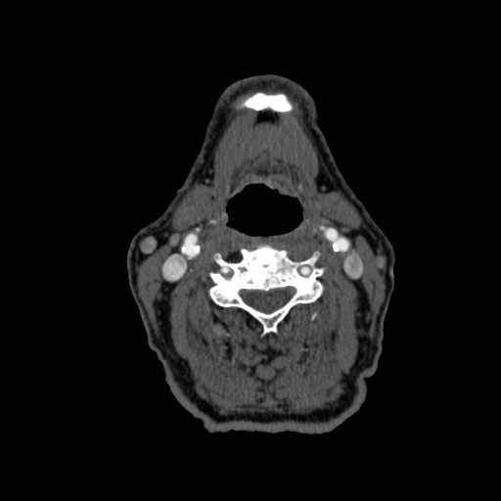

Slide 62
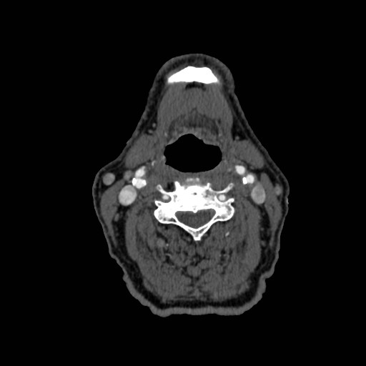

Slide 63
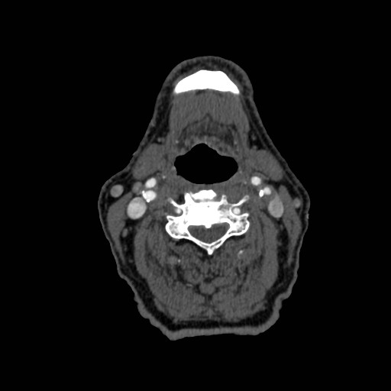

Slide 64


Slide 65
L ICA Occlusive Disease
DIFFERENTIAL DIAGNOSIS
  Atherosclerotic Vascular Disease
    Smooth/irregular narrowing of proximal ICA, Ca++ in arterial walls
    ICA, vertebrobasilar arteries most common sites
  Dissection
    Typically spares carotid bulb; no calcification
    Seen in young or middle-aged groups
    Smoother, longer narrowing without intracranial involvement
  Fibromuscular Dysplasia
    "String of beads" > > long-segment stenosis
  Vasospasm
    Usually iatrogenic (catheter-induced), transient

Slide 66
L ICA Athersclerotic Disease
Protocol
  Color Doppler US as initial screen
  CTA/MRA or contrast MRA
  Consider DSA prior to carotid endarectomy, in equivocal cases or if CTA/MRA shows "occlusion"
Diagnostic Checklist
  DSA remains "gold standard" but acceptable noninvasive preoperative imaging includes any 2 of
  US, CTA, TOF, or contrast-enhanced MRA
  Late-phase DSA important to rule out "pseudo-occlusion"
    High-grade stenosis with "string" sign

Slide 67
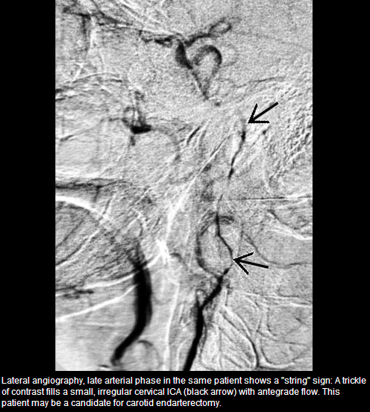
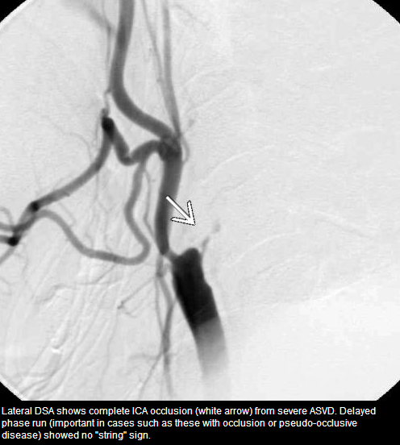

Slide 68
L ICA Athersclerotic Disease
Pathology
  NASCET method: % stenosis = (normal lumen - minimal residual lumen)/normal lumen, x 100
  Mild (< 50%), moderate (50-70%), severe (70-99%)
Treatment
  Carotid endarterectomy (CEA) if symptomatic carotid stenosis ≥ 70% (NASCET)
  Symptomatic moderate stenosis (50-69%) also benefits from CEA (NASCET)
  Asymptomatic patients benefit even with stenosis of 60% (ACAS)
  ICA stenting depends on preoperative risk factors

Slide 69
CAS vs CEA
Extensively studied
  ACAS: Asymptomatic Carotid Artery Stenosis
  NASCET: North American Symptomatic Carotid Endarterectomy Trial
  ICSS International Carotid Stenting Study in Europe
  CREST: Carotid Revascularization Endarterectomy vs Stenting Trial
  SPACE: Stent-Supported Percutaneous Angioplasty of the Carotid Artery versus Endarterectomy
  EVA-3S: Endarterectomy versus Angioplasty in Patients with Symptomatic Severe Carotid Stenosis
  SAPPHIRE: Stenting and Angioplasty with Protection in Patients at High Risk for Endarterectomy

Slide 70
CAS vs CEA
Large meta-analysis May 2012 in Ann Vasc Surg
Thirteen trials. 7,501 patients
Odds ratios (ORs) were calculated for CAS versus CEA.
  Risk of stroke or death within 30 days was higher after CAS than CEA (OR = 1.57; 95% confidence interval [CI] = 1.11-2.22),
    especially in previously symptomatic patients (OR = 1.89; 95% CI = 1.48-2.41)
  Stroke or death within 1 year was comparable (OR = 1.12; 95% CI = 0.55-2.30).
  Subgroup analysis, the risk of death and disabling stroke at 30 days did not differ significantly between CEA and CAS (death: OR = 1.43; 95% CI = 0.85-2.40; disabling stroke: OR = 1.28; 95% CI = 0.89-1.83)
  Rate of nondisabling stroke within 30 days was much higher in the CAS group (OR = 1.87; 95% CI = 1.40-2.50).
  The risks of myocardial infarction within 30 days and 1 year were significantly less for CAS.

Slide 71
References
Osborn, A. StatDx. Intracranial Internal Carotid Artery. Accessed 7/25/12.
StatDX Neuroanatomy Images
Osborn, A. StatDx. Intracranial Arteries Overview. Accessed 7/25/12.
Brownwyn, E. H. StatDx. Atherosclerosis, Extracranial. Accessed 7/25/12.
Liu, Z. J. et al. Updated Systematic Review and Meta-Analysis of Randomized Clinical Trials Comparing Carotid Artery Stenting and Carotid Endarterectomy in the Treatment of Carotid Stenosis. Ann Vasc Surg. 2012 May; 26(4):576-90.

